Slide 1

Naïve Bayes, KNN, KMeans & Decision Trees
Thilanka Munasinghe
Data Analytics
ITWS-4600/ITWS-6600/MATP-4450/CSCI-4960
September 29th, 2020

Slide 2
Naïve Bayes – what is it?
Naïve Bayes Classifier
Components of the Baye’s Rule
What does it mean by Naïve
Notes:
https://en.wikipedia.org/wiki/Naive_Bayes_classifier

Slide 3
Naïve Bayes
Naïve Bayes model uses a probabilistic approach to do a classification.
In Naïve Bayes, the relationship between the input features and the classes are defined using the probabilities.
Before diving into Naïve Bayes, you should understand the basic Probability Theories/Concepts.
Probability is the measure of the likelihood that an event will occur.
https://en.wikipedia.org/wiki/Naive_Bayes_classifier
https://en.wikipedia.org/wiki/Probability
Notes:
https://en.wikipedia.org/wiki/Probability
https://en.wikipedia.org/wiki/Naive_Bayes_classifier

Slide 4
Naïve Bayes
The class with the highest probability value determines the label for the sample.
Naïve Bayes classifier uses the Bayes Theorem by Thomas Bayes.
https://en.wikipedia.org/wiki/Naive_Bayes_classifier
Image/Photo Credit: https://en.wikipedia.org/wiki/Thomas_Bayes
Notes:
https://en.wikipedia.org/wiki/Bayes%27_theorem
https://en.wikipedia.org/wiki/Probability
https://en.wikipedia.org/wiki/Naive_Bayes_classifier

Slide 5
Naïve Bayes
In Naïve Bayes, we assume that input features are statistically independent from each other, which means, for a given class the value of one particular feature doesn’t affect the value of another feature.
In reality, this assumption is little bit oversimplified and not true most of the time, because of that we say this assumption is naïve
https://en.wikipedia.org/wiki/Naive_Bayes_classifier
https://en.wikipedia.org/wiki/Bayes%27_theorem
Notes:
The naïve independence assumption with the use of Bayes theorem gives the classification model name Naïve Bayes.
https://en.wikipedia.org/wiki/Bayes%27_theorem
https://en.wikipedia.org/wiki/Probability
https://en.wikipedia.org/wiki/Naive_Bayes_classifier

Slide 6
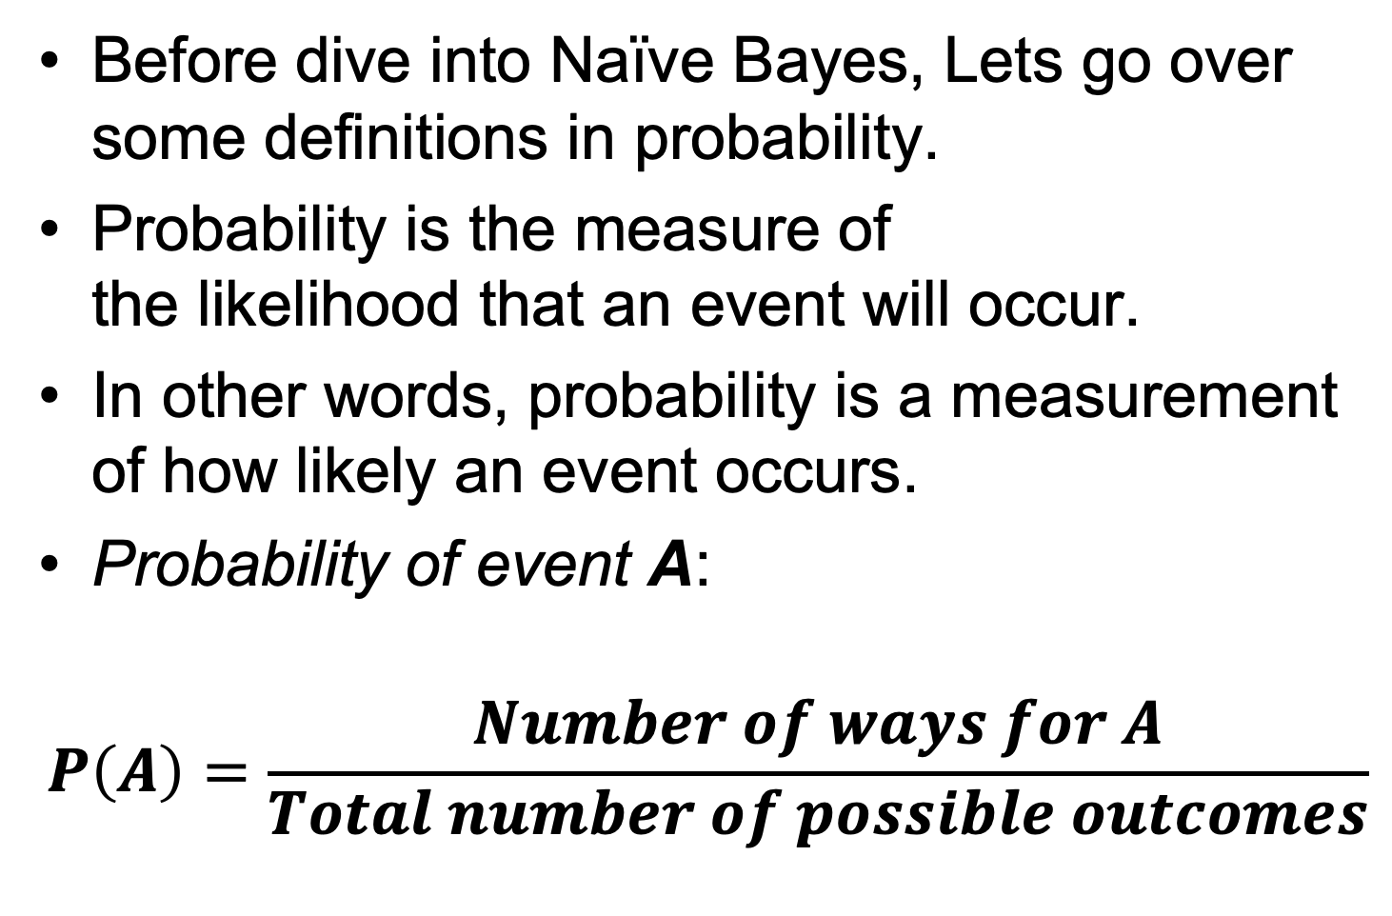
Probability …
Before dive into Naïve Bayes, Lets go over some definitions in probability.
Probability is the measure of the likelihood that an event will occur.
In other words, probability is a measurement of how likely an event occurs.
Probability of event A:
$$P\left(A\right)=\frac{Number of ways for A}{Total number of possible outcomes}$$
Reference: https://en.wikipedia.org/wiki/Probability
Notes:
https://en.wikipedia.org/wiki/Probability

Slide 7
Probability …
Before dive into Naïve Bayes, You should know/understand the two probability concepts:
1) Joint Probability
2) Conditional Probability
Reference: https://en.wikipedia.org/wiki/Probability
Notes:
https://en.wikipedia.org/wiki/Probability

Slide 8
Probability …
Joint Probability: specifies the probability of event A and event B occurring together.
Joint Probability A and B
P(A)
P(B)
P(A,B)
https://en.wikipedia.org/wiki/Joint_probability_distribution
Notes:
https://en.wikipedia.org/wiki/Probability
https://en.wikipedia.org/wiki/Joint_probability_distribution
Image/Photo Credit: https://pngtree.com/freepng/two-dice_1504759.html

Slide 9
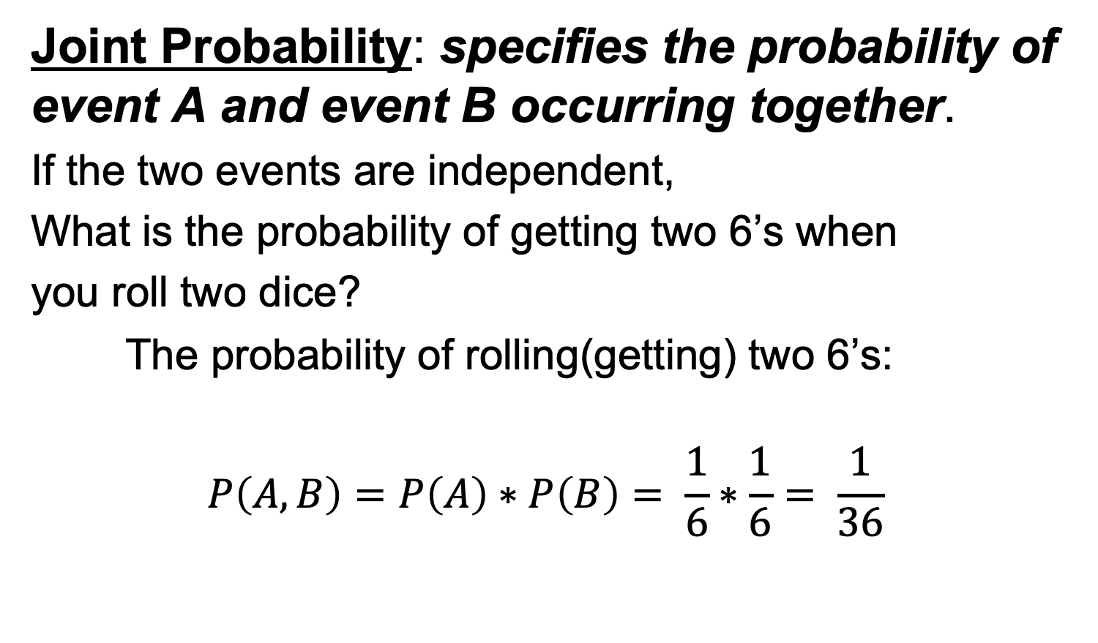
Probability …
Joint Probability: specifies the probability of event A and event B occurring together.
If the two events are independent,
What is the probability of getting two 6’s when
you roll two dice?
The probability of rolling(getting) two 6’s:
$$P\left(A,B\right)=P\left(A\right)∗P\left(B\right)= \frac{1}{6}∗\frac{1}{6}= \frac{1}{36}$$
https://en.wikipedia.org/wiki/Joint_probability_distribution
Image/Photo Credit: https://pngtree.com/freepng/two-dice_1504759.html
Notes:
https://en.wikipedia.org/wiki/Probability
https://en.wikipedia.org/wiki/Joint_probability_distribution
Image/Photo Credit: https://pngtree.com/freepng/two-dice_1504759.html

Slide 10
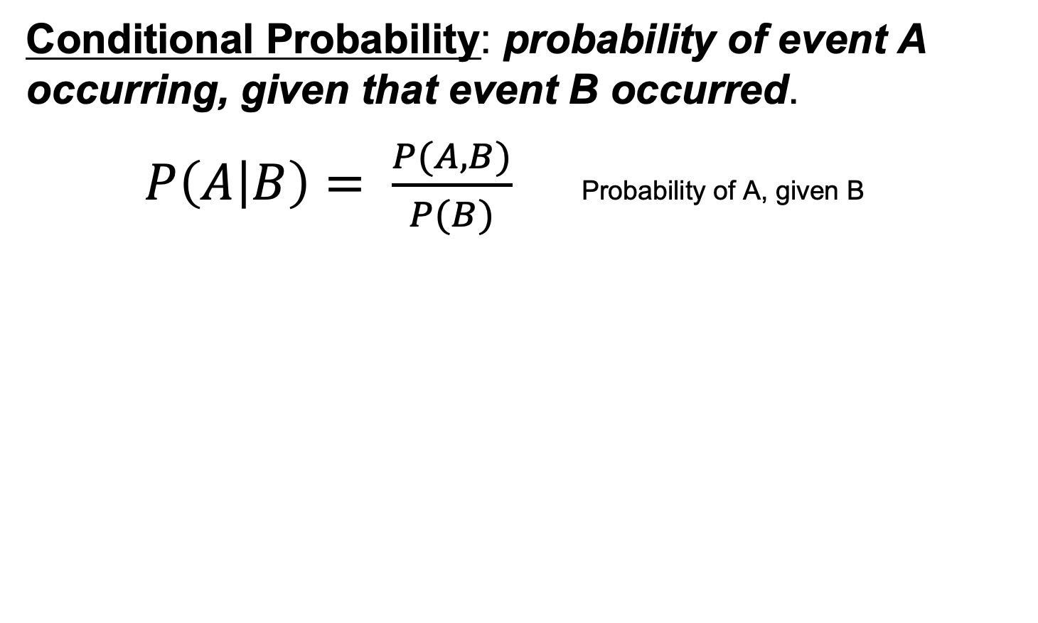
Probability …
Conditional Probability: probability of event A occurring, given that event B occurred.
$P\left(A | B\right)= \frac{P(A,B)}{P(B)}$Probability of A, given B
P(A)
P(B)
P(A,B)
https://en.wikipedia.org/wiki/Conditional_probability
Notes:
Another way of saying this is event A is conditioned on event B.
The joint probability divided by probability of B
https://en.wikipedia.org/wiki/Probability
https://en.wikipedia.org/wiki/Conditional_probability

Slide 11
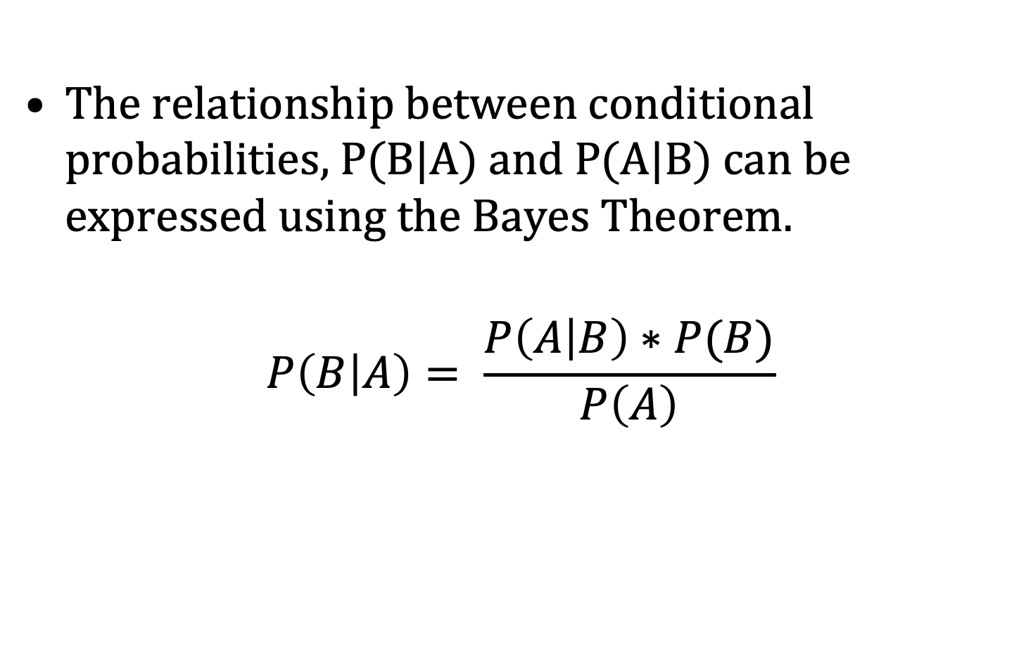
Bayes Theorem…
The relationship between conditional probabilities, P(B|A) and P(A|B) can be expressed using the Bayes Theorem.
$$P\left(B | A\right)= \frac{P\left(A | B\right)∗P(B)}{P\left(A\right)}$$
Reference: https://en.wikipedia.org/wiki/Bayes%27_theorem
Notes:
Bayes theorem express the relationship between probability of A given B and probability of B given A as stated in this equation.
https://en.wikipedia.org/wiki/Probability

Slide 12
Classification using Probabilities
With given features X = (x₁,x₂,x₃,…,x_{k} )
Predict the class C = (C₁,C₂,C₃,…,C_{i} )
We can do this by finding the value of C that,
maximize the P(C|X)
P(C₁|X)
P(C₂|X)
P(C₃|X)
. Max Class Label
.
P(C_{i}|X)
Notes:
X is the set of values for the input features in the our sample.
Given the sample with features X, predict the corresponding class C.

Slide 13
In order to find the class label C, we need to find the conditional probability of class C given X for all classes and choose the class that has the highest probability.
It is difficult to estimate the P(C|X) so we use Bayes theorem to simplify this problem.

Slide 14
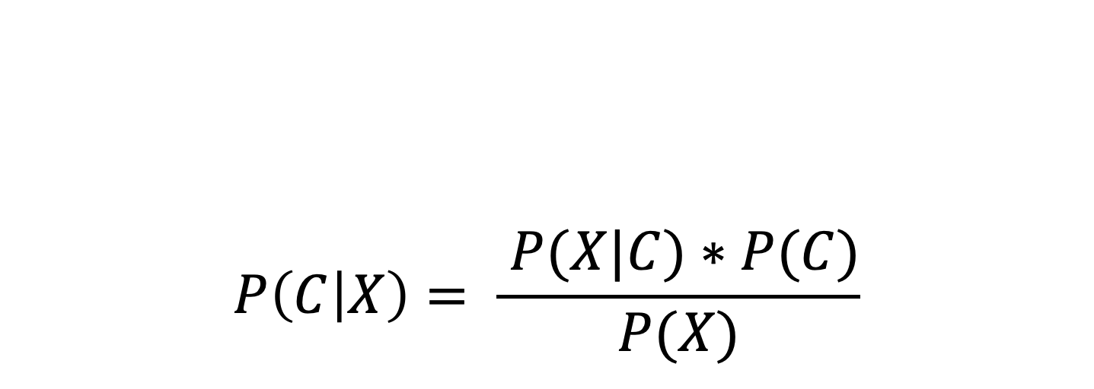
$$P\left(C | X\right)= \frac{ P(X|C)∗P(C)}{P(X)}$$
Conditional Probability
Prior Probability
Posterior Probability
Probability of observing
X values for input features
Notes:
Slide Resource: Machine Learning with Big Data from UCSD and Stanford University

Slide 15
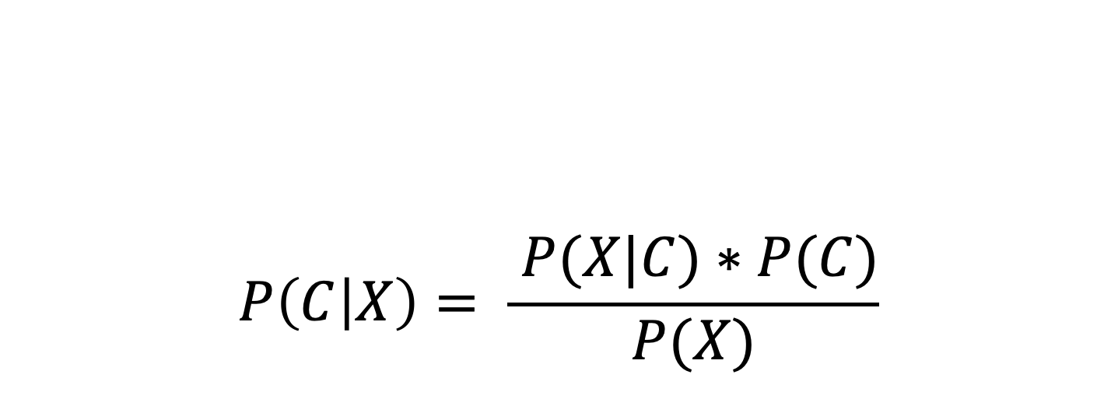
Bayes Theorem in Classification
$$P\left(C | X\right)= \frac{ P(X|C)∗P(C)}{P(X)}$$
This can be estimated from the training
sample data
It is a constant, and it can be
Ignored (probability of X
doesn’t depend of the
class C, since it is same for all
classes, it can be removed from the calculation of probability of C given X)
This is what we are looking for
To find P(C|X) we only need to find the P(X|C) and P(C) which
can be estimated from the data
Notes:
https://en.wikipedia.org/wiki/Naive_Bayes_classifier
Resource: UCSD Machine Learning with Big Data

Slide 16
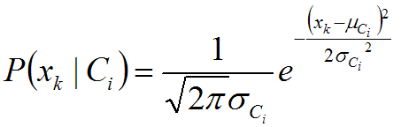
P(x_{k} | C_{i}) is estimated from the training samples
Categorical: Estimate P(x_{k} | C_{i}) as percentage of samples of class i with value x_{k}
Training involves counting percentage of occurrence of each possible value for each class
Numeric: Actual form of density function is generally not known, so “normal” density (i.e. distribution) is often assumed

Slide 17
Digging into iris
## Call the NaiveBayes Classifier Package e1071, which auto calls the Class package ##
library("e1071")
classifier<-naiveBayes(iris[,1:4], iris[,5])
table(predict(classifier, iris[,-5]), iris[,5], dnn=list('predicted','actual'))
classifier$apriori
classifier$tables$Petal.Length
plot(function(x) dnorm(x, 1.462, 0.1736640), 0, 8, col="red", main="Petal length distribution for the 3 different species")
curve(dnorm(x, 4.260, 0.4699110), add=TRUE, col="blue")
curve(dnorm(x, 5.552, 0.5518947 ), add=TRUE, col = "green")
Standard Deviation
mean
We will do this during the next Lab…
Notes:
From where did I get the “mean” and ”SD” numbers ? I calculated the Mean and Standard Deviation for each iris type

Slide 18
Notes:
This is a distribution plot, its smooth curve. For each of the 3 species of Iris. And it is a function of “Patel-Length”
Red Setosa, separated, Versicolor and Verginca overlapping each other , I’m plotting the probability distributions. (I’m not plotting the dataset), Assumed the Normal-distributions here. “dnorm”– function is for the normal distribution.

Slide 19
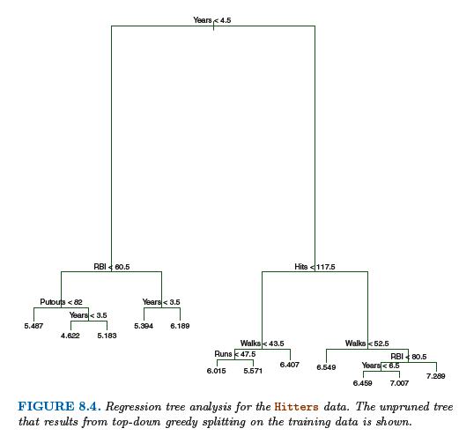
Decision Trees
Decision trees can be applied to both regression and classification problems
Image Credit: Introduction to Statistical Learning with R -7 Edition: Chapter 8
Reference/Resources: Introduction to Statistical Learning with R -7 Edition: Chapter 8

Slide 20
Advantages and Disadvantages of Decision Trees
Decision trees for regression and classification have number of advantages and disadvantages
Advantages:
Trees are very easy to explain to people, in fact, they are even easier to explain than linear regression.
Some people believe that decision trees are more closely mirror human decision-making than other regression and classification techniques.
Trees can be displayed graphically, and easily interpreted even non-experts (especially if the tree is small) can understand.
Reference/Resources: Introduction to Statistical Learning with R -7 Edition: Chapter 8
Notes:
Trees can easily handle qualitative predictors without the need to create dummy variables

Slide 21
Advantages and Disadvantages of Decision Trees
Decision trees for regression and classification have number of advantages and disadvantages
Disadvantages:
Unfortunately, trees generally do not have the same level of predictive accuracy as some of the other regression and classification approaches
Additionally, trees can be very non-robust. In other words, a small changes in the data can cause a large change in the final estimated tree
However, by aggregating many decision trees, using methods like bagging, random forest and boosting, the predictive performance of trees can be substantially improved.
Reference/Resources: Introduction to Statistical Learning with R -7 Edition: Chapter 8

Slide 22
Decision Tree - Classification
When we implement decision trees for classification, the idea is to split the data into subsets. So that each subset is belong to one particular class.
In other words, splitting the data into regions, that are separated by decision boundaries, where each regions with a sample that has only one class.

Slide 23
Decision Trees
Decision Trees are popular method that used for the classification purpose.
Image/Photo Credit: https://en.wikipedia.org/wiki/Decision_tree_learning#/media/File:CART_tree_titanic_survivors.png
Notes:
https://en.wikipedia.org/wiki/Decision_tree_learning

Slide 24
Decision Tree
Decision Tree has a hierarchical structure with “nodes” and “directed edges”
The top node is define as the “root node” and the nodes at the bottom are called as “leaf nodes”

Slide 25
Decision Tree
Nodes that are neither root node nor the leaf nodes are identified as “internal nodes” in the decision tree.
For each leaf node, there is a ”class label” associate with it (There is a “class label” associated with each leaf node)

Slide 26
Decision Tree
Classification decisions are made by traversing the decision tree (By traversing the decision tree, classification decisions are made)
Traversing start from the root node (from the top of the tree).
The root node and the internal nodes have test conditions. Those test conditions determine which path to traverse on the tree.

Slide 27
Decision Tree
When reached a leaf node through traversing, the category of the leaf node determine the classification.
The depth is measured from the root node and the depth at the root node is zero.

Slide 28
Decision Tree
In decision trees, the depth of node is determined by number of edges from the root node to that particular node.
The depth of the decision tree: Depth is calculated by counting the number of edges in the longest path from the root node to a leaf node.

Slide 29
Decision Tree
Number of nodes in the decision tree determine the size of the tree.
Decision tree constructing algorithm is referred to as a tree induction algorithm.

Slide 30
Impurity Measure
Goal is to have the resulting subsets to be homogeneous as possible and minimize the impurity.
In practice, we don’t get pure homogeneous subsets, there are impurities.
A common impurity measure to determining the best split is “Gini-index”
The lower the Gini-index value, the higher the purity of the split.

Slide 31
Impurity Measure
The decision tree will select the split that minimize the Gini-index.
Besides the Gini-index, there are other impurity measures available such as:
- entropy or information gain
- misclassification rate

Slide 32
The decision tree will test all variables to determine the best way to split a node using a purity measure such as Gini-index to compare different possibilities
Tree induction algorithm repeatedly split nodes to get more and more homogeneous subsets.
When this process stops? When does the algorithm stops growing the tree?

Slide 33
When to Stop splitting the nodes?
There are several criteria that can be used to determine the when a node shouldn’t be split into subsets.
The induction algorithm can stop expanding a node when all samples in the node have the same class label.
Since getting pure subsets is difficult to archive with real world data, the stopping criteria can be modified to archive certain percentage of the samples in the node. i.e 95% of have the same class label.

Slide 34
Stopping criteria
Algorithm can stop expanding a node when the number of samples in the node falls below a certain minimum number.
Induction algorithm can stop expanding a node when the improvement in impurity measure is way too small to measure (too small to make a much difference in classification result).
Also, algorithm can stop expanding when it reach the maximum of the tree-depth.

Slide 35
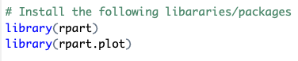
# Decision Trees --
# Classification Tree
# Install the following libararies/packages in RStudio
library(rpart)
library(rpart.plot)

Slide 36
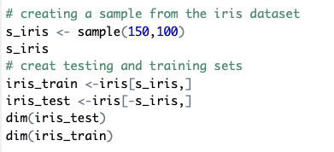
# we will be using the iris dataset
iris
dim(iris)
# creating a sample from the iris dataset
s_iris <- sample(150,100)
s_iris
# creat testing and training sets
iris_train <-iris[s_iris,]
iris_test <-iris[-s_iris,]
dim(iris_test)
dim(iris_train)

Slide 37
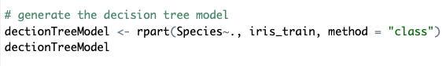
# generate the decision tree model
dectionTreeModel <- rpart(Species~., iris_train, method = "class")
dectionTreeModel

Slide 38
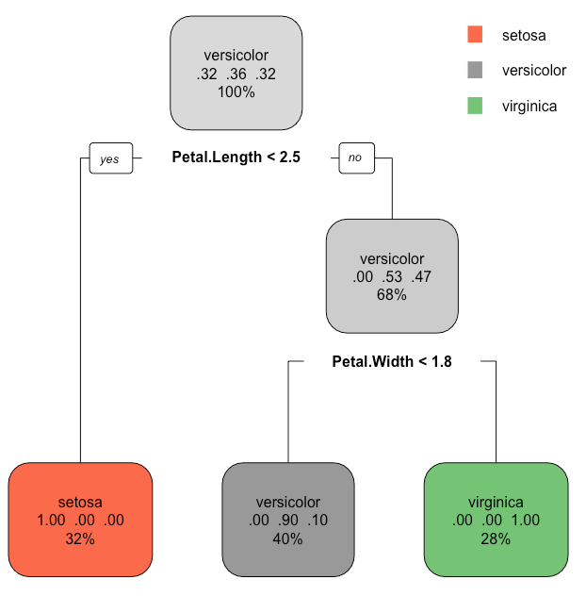
#plotting the decision tree model using #rpart.plot() function
rpart.plot(dectionTreeModel)

Slide 39
rpart.plot(dectionTreeModel)

Slide 40
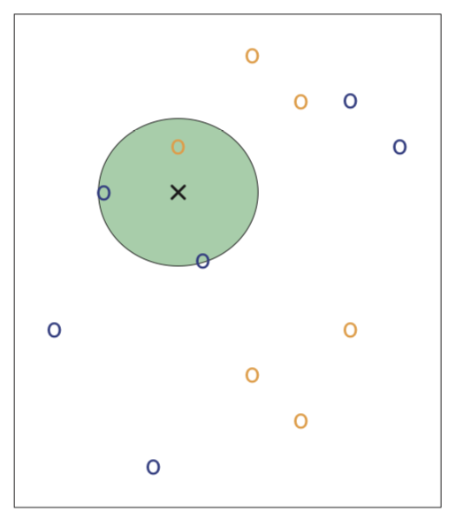
KNN Classifier
In the figure shown, it has a dataset consisting 6 blue and 6 orange observations.
Our goal is to make a prediction for the point labeled by the black cross.
Suppose we choose K=3, then KNN will first identify the three observations that are closes to the black cross as shown in the figure.
This neighborhood is shown as a circle. It consist of 2 blue points and 1 orange point, resulting in estimated probabilities of 2/3 for the blue class and 1/3 for the orange class.
Hence, KNN will predict that the black cross belongs to the blue class.
Image/photo Credit: Introduction to Statistical Learning with Applications in R, 7th Edition, Chapter 2
Reference: Introduction to Statistical Learning with Applications in R, 7th Edition, Chapter 2 – KNN Classifier

Slide 41
6 blue points and 6 orange points
Image/photo Credit: Introduction to Statistical Learning with Applications in R, 7th Edition, Chapter 2
Reference: Introduction to Statistical Learning with Applications in R, 7th Edition, Chapter 2 – KNN Classifire

Slide 42
K-Means
K-Means clustering is an unsupervised learning algorithm that, as the name hints, finds a fixed number (k) of clusters in a set of data.
A cluster is a group of data points that are grouped together due to similarities in their features. When using a K-Means algorithm, a cluster is defined by a centroid, which is a point (either imaginary or real) at the center of a cluster.
Every point in a data set is part of the cluster whose centroid is most closely located. To put it simply, K-Means finds k number of centroids, and then assigns all data points to the closest cluster, with the aim of keeping the centroids small
Resource: https://blog.easysol.net/machine-learning-algorithms-3/
https://blog.easysol.net/author/acorrea/
Notes:
https://blog.easysol.net/machine-learning-algorithms-3/
https://blog.easysol.net/author/acorrea/

Slide 43
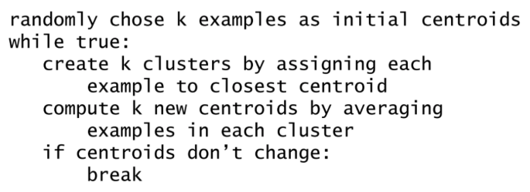
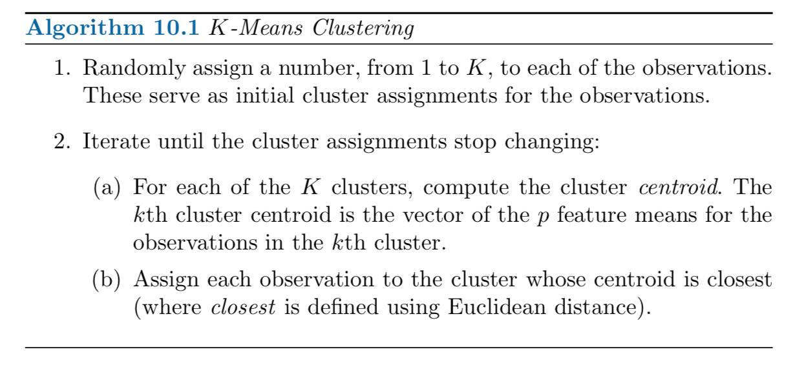
K-Means Algorithm
Resource: MIT 6.0002 lecture 12 ( MIT Open Courseware)
https://ocw.mit.edu/index.htm
Reference: Introduction to Statistical Learning with Applications in R, 7th Edition, Chapter 10 – KMeans

Slide 44
K-Means Algorithm
Reference: Introduction to Statistical Learning with Applications in R, 7th Edition, Chapter 10 – KMeans

Slide 45
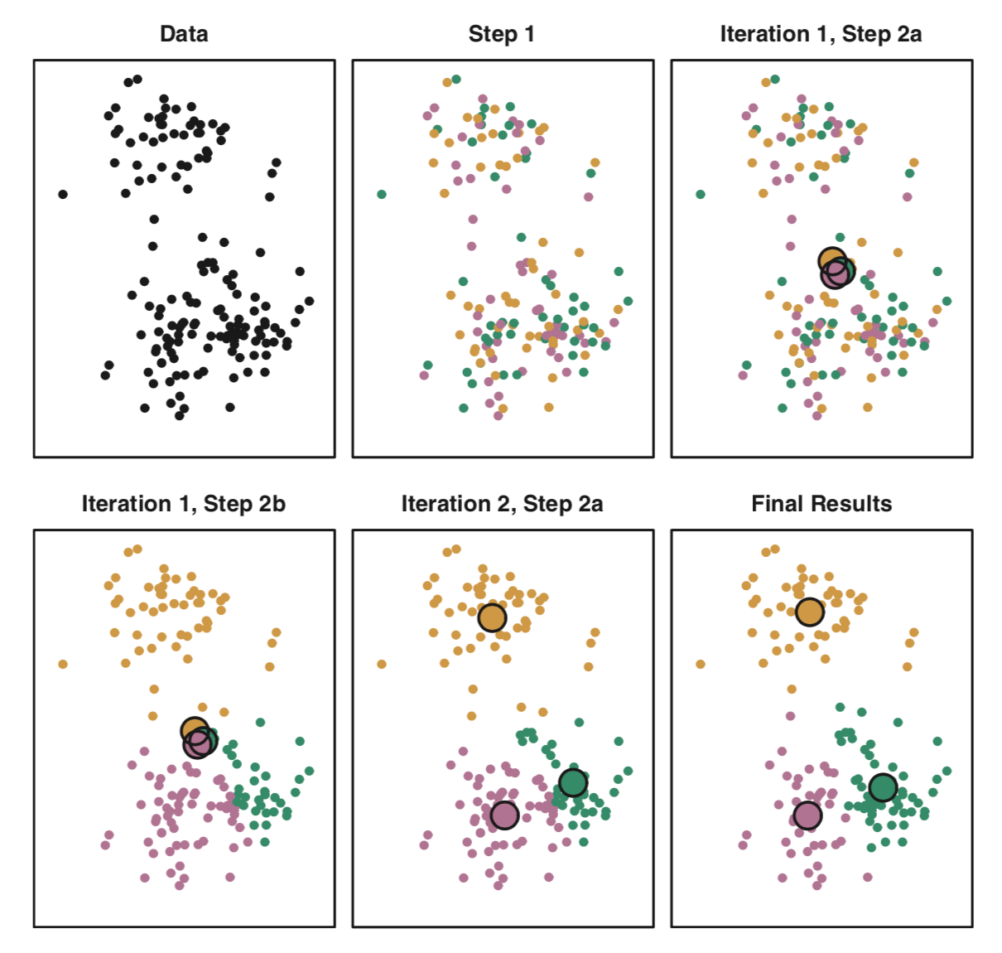
Image/Photo Credit: Introduction to Statistical Learning with Applications in R, 7th Edition, Chapter 10 – KMeans
Reference: Introduction to Statistical Learning with Applications in R, 7th Edition, Chapter 10 – KMeans

Slide 46
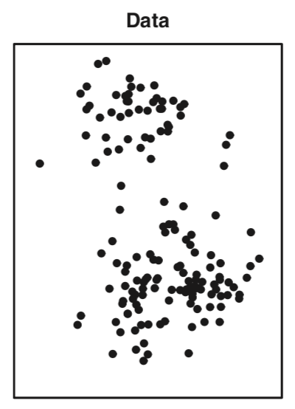
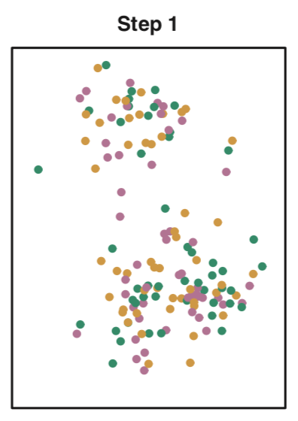
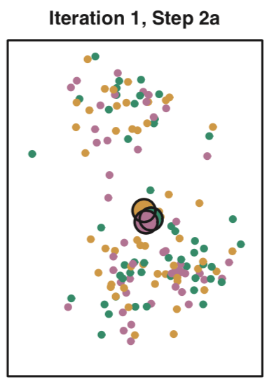
The progress of the K-means algorithm
Observations (data) is shown
Step 1 of the algorithm: each observation is randomly assigned to a cluster
Iteration1 Step 2(a): The cluster centroids are computed, these are shown in large colored disks. Initially centroids are almost completely overlapping because the initial cluster assignment were chosen at random
Image/Photo Credit: Introduction to Statistical Learning with Applications in R, 7th Edition, Chapter 10 – KMeans
Reference: Introduction to Statistical Learning with Applications in R, 7th Edition, Chapter 10 – KMeans

Slide 47
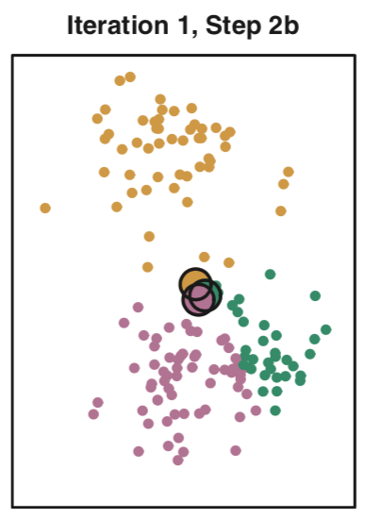
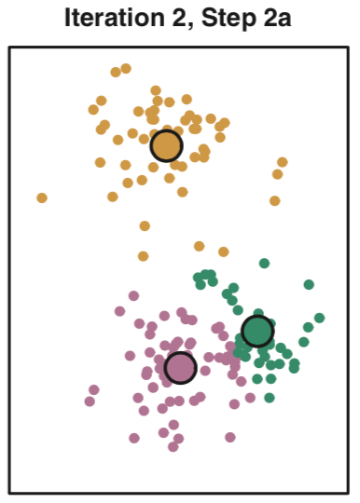
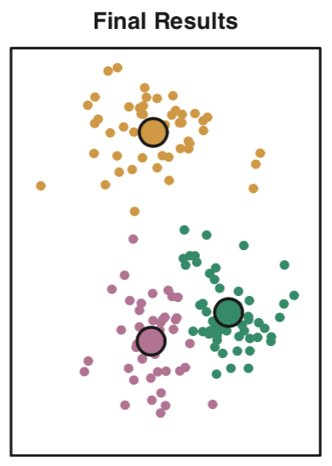
The progress of the K-means algorithm
Iteration 1 Step 2(b) : each observation is assigned
to the nearest centroid
Iteration 2, Step 2(a): the step 2(a) is once again performed, leading to new cluster centroids.
Final Results: the results obtained after ten iterations. You can see the distinct clusters with their centroids.
Image/Photo Credit: Introduction to Statistical Learning with Applications in R, 7th Edition, Chapter 10 – KMeans
Reference: Introduction to Statistical Learning with Applications in R, 7th Edition, Chapter 10 – KMeans

Slide 48
K-Means clustering Animation
http://shabal.in/visuals/kmeans/6.html

Slide 49
Read the rpart() documentation
https://www.rdocumentation.org/packages/rpart/versions/4.1-13/topics/rpart
Read the rpart.plot() documentation
https://www.rdocumentation.org/packages/rpart.plot/versions/3.0.6/topics/rpart.plot

Slide 50
In-Class Exercise: KNN - Abalone
# abalone dataset from UCI repository
# reading the dataset from UCI repository URL
abalone <- read.csv(url("https://archive.ics.uci.edu/ml/machine-learning-databases/abalone/abalone.data"), header = FALSE, sep = ",")
# Column names
colnames(abalone) <- c("sex", "length", 'diameter', 'height', 'whole_weight', 'shucked_wieght', 'viscera_wieght', 'shell_weight', 'rings' )
# summary on abalone
summary(abalone)
# structure of the abalone data
str(abalone)
# summary of the abalone rings column
summary(abalone$rings)
# As shown above, the “rings” variable has a range between 1-29.
# This is the variable that we want to predict, and predicting this many levels
# might not give us the insight we’re looking for.
# For now, we’ll break the rings variable
# into 3 levels" “young” for abalones less than 8, “adult” for abalones between 8-11,
# and “old” for abalones older than 11.
abalone$rings <- as.numeric(abalone$rings)
abalone$rings <- cut(abalone$rings, br=c(-1,8,11,35), labels = c("young", 'adult', 'old'))
abalone$rings <- as.factor(abalone$rings)
summary(abalone$rings)
# remove the "sex" variable in abalone, because KNN requires all numeric variables for prediction
# z <- abalone
aba <- abalone
aba$sex <- NULL

Slide 51
In-Class Exercise KNN – Abalone continue…
# normalize the data using min max normalization
normalize <- function(x) {
return ((x - min(x)) / (max(x) - min(x)))
}
aba[1:7] <- as.data.frame(lapply(aba[1:7], normalize))
summary(aba$shucked_wieght)
# After Normalization, each variable has a min of 0 and a max of 1.
# in other words, values are in the range from 0 to 1.
# We’ll now split the data into training and testing sets.
ind <- sample(2, nrow(aba), replace=TRUE, prob=c(0.7, 0.3))
KNNtrain <- aba[ind==1,]
KNNtest <- aba[ind==2,]
sqrt(2918)
# make k equal to the square root of 2918, the number of observations in the training set.
# sqrt(2918) ~= 54.01852 round it to 55 and use k = 55 # We usually take an Odd number for k value,
# knn model
# knn() is in the "class" library. Make sure to install it first on your RStudio.
library(class)
help("knn") # Read the knn documentation on RStudio.
KNNpred <- knn(train = KNNtrain[1:7], test = KNNtest[1:7], cl = KNNtrain$rings, k = 55)
KNNpred
table(KNNpred)

Slide 52
In-Class Exercise K-Means Iris dataset
# iris dataset is from UCI ML repository.
# kmeans clustering example from Rpubs by RStudio: https://rpubs.com/AnanyaDu/361293
library(ggplot2) # we will use ggplot2 to visualize the data.
head(iris) # first 6 rows of the
str(iris) # take a look at the structure of the iris data using str() function in R.
# dataset has 150 observations equally distributed observations among
# the three species: Setosa, Versicolor and Verginica.
summary(iris) # summary statistics of all the 4 variables Sepal.Length,Sepal.Width,
# Petal.Length and Petal.Width
help("sapply")
sapply(iris[,-5], var)
summary(iris)
# plot Sepal.Length Vs Sepal.Width using ggplot
ggplot(iris,aes(x = Sepal.Length, y = Sepal.Width, col= Species)) + geom_point()
# plot Petal.Length Vs Sepal.Width using ggplot
ggplot(iris,aes(x = Petal.Length, y = Petal.Width, col= Species)) + geom_point()
# kmeans clustering
# Read the documentation for kmeans() function
# https://stat.ethz.ch/R-manual/R-devel/library/stats/html/kmeans.html
set.seed(300)
k.max <- 12
# tot.withinss = Total within-cluster sum of square
# iter.max = the maximum number of iterations allowed
# nstart = if centers is a number, how many random sets should be chosen.
wss<- sapply(1:k.max,function(k){kmeans(iris[,3:4],k,nstart = 20,iter.max = 20)$tot.withinss})
wss # within sum of squares.
plot(1:k.max,wss, type= "b", xlab = "Number of clusters(k)", ylab = "Within cluster sum of squares")
icluster <- kmeans(iris[,3:4],3,nstart = 20)
table(icluster$cluster,iris$Species)
# In the table we can see that most of the observations have been clustered correctly
# however, 2 of the versicolor have been put in the cluster with all the virginica
# and 4 of the verginica have been put in cluster 3 which mostly has versicolor.

Slide 53
In-Class Exercises on Trees
# Classification ctrees
# iris data set
# Install the following libararies/packages
library(rpart)
library(rpart.plot)
# we will be using the iris dataset
iris
dim(iris) # check the dimensions of the iris dataset
# creating a sample from the iris dataset
s_iris <- sample(150,100)
s_iris
# creat testing and training sets
iris_train <-iris[s_iris,]
iris_test <-iris[-s_iris,]
dim(iris_test)
dim(iris_train)
# generate the decision tree model
dectionTreeModel <- rpart(Species~., iris_train, method = "class")
dectionTreeModel
#plotting the decision tree model using rpart.plot() function
rpart.plot(dectionTreeModel)

Slide 54
Practice on Dplyr Example
Work/practice on the code snippet “Data Manipulation using Dplyr” (code snippet available on LMS). HINT: This practice will help you to do some of the Lab2 questions)
# Dplyr for Data Manipulating
# Tidyr for Data Cleaning
# Pipe Operator %>%
The code snippet available on LMS under this week course content

Slide 55
References
https://en.wikipedia.org/wiki/Naive_Bayes_classifier
https://en.wikipedia.org/wiki/Probability
https://en.wikipedia.org/wiki/Bayes%27_theorem
https://www.analyticsvidhya.com/blog/2017/02/basic-probability-data-science-with-examples/
https://towardsdatascience.com/decision-trees-d07e0f420175
Decision Tree Learning http://www.doc.ic.ac.uk/~sgc/teaching/pre2012/v231/lecture11.html
https://www.datacamp.com/community/tutorials/decision-trees-R
Introduction to Statistical Learning with Applications in R, 7th Edition, Chapter 10 – KMeans

Slide 56
Datasets check !
Make sure to check with the instructor or TA
about your project proposal dataset.
( By now you should have selected a dataset or a plan to choose a dataset, if not speak to me before end of the today’s class…)
2) Show your “dataset” that you are planning work with, we need to document it so that we know if there are multiple students working on the same dataset. (This is important! Make sure to check-in your project dataset with the instructor before end of the Friday (10/02/2020 lab)

